Slide 1

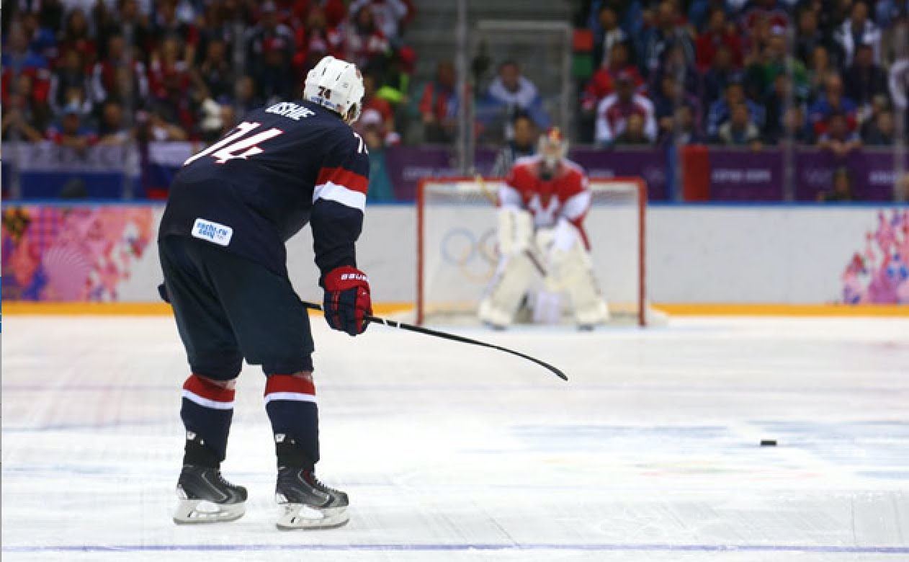
Fast or Slow? Investigating Player Approach Speed in National Hockey League Shootouts and its Effect on Performance
Matt D. Hoffmann, Matthieu M. Boisvert, Piotr A. Piasecki, Todd M. Loughead, & Jess C. Dixon
Department of Kinesiology, University of Windsor
Introduction
Analysis
Model | OR | 95% CI | R²
Block 1 |  |  | .002
Moderate Speed Slow Speed Approach Tactic Shot Type | 1.03 1.03 .87 .94 | [.83, 1.27] [.83, 1.29] [.73, 1.04] [.78, 1.12]
Block 2 |  |  | .300
Moderate Speed Slow Speed Approach Tactic Shot Type Shooter Percentage | 1.00 .95 .83 .94 1.06 | [.79, 1.27] [.74, 1.23] [.68, 1.00] [.77, 1.15] [1.05, 1.06]
Evidence from professional soccer suggests that time spent preparing for penalty kicks predicts performance. Using a liberal alpha level, Jordet and Hartman (2008) reported that players who prepared their kicks slowly were 73% more likely to have scored in soccer shootouts than players who prepared their kicks quickly (p = .098). The authors surmised that, to get the stressful shootout “over with,” some players rushed their shots, resulting in poor performance.
Similar to professional soccer contests, National Hockey League (NHL) regular season games that are tied following the overtime period are decided by a shootout.
Determining if player approach speed in NHL shootouts plays a role in shootout performance would be valuable to NHL players, coaches, and management.
Shootout videos were imported into a software program where they were analyzed frame-by-frame. That is, the speed at which each player approached the opposing team’s goaltender in each shootout was recorded, as was each player’s approach tactic and shot type.
Consistent with Jordet and Hartman (2008), we conducted a tertiary split and created three groups representing different approach speeds: fast (1.52-3.68sec; n = 849 shootouts), moderate (3.69-4.27sec; n = 840 shootouts), and slow (4.28-8.01sec; n = 862 shootouts).
Hierarchical binary logistic regression analysis was conducted to determine whether the independent variables predicted scoring likelihood.
Study Objectives
Results
Table 1. Summary of study results.
Note. “Fast speed” served as the reference category.
Building on shootout research in the NHL (Hoffmann et al., 2017; McEwan et al., 2012), the main objective of this study was to explore whether player approach speed predicted performance in NHL shootouts.
Based on Jordet and Hartman’s (2008) findings from soccer, we hypothesized that players with slow or moderate approach speeds would be more likely to score in NHL shootouts than players with fast approach speeds.
For exploratory purposes, we also examined whether approach tactic (i.e., direct or indirect) or shot type (i.e., shot or deke) predicted shootout performance.
We adjusted for end-of-season player shootout scoring percentage in our analysis given that few, if any, predictors of shootout success exist after accounting for player quality (Lopez & Schuckers, 2017).
Discussion
The findings are summarized in Table 1.
The results of Block 1 (not including player shootout scoring percentage) indicated that neither player approach speed, approach tactic, nor shot type predicted shootout performance. The variance accounted for in Block 1 was negligible.
The results of Block 2 (including player shootout scoring percentage) similarly indicated that neither player approach speed, approach tactic, nor shot type predicted shootout performance. However, player shootout scoring percentage was positively related to shootout performance, suggesting that players with greater average shootout scoring percentages had slightly greater odds of scoring. Substantially more variance was accounted for in Block 2.
Contrary to our hypothesis, the findings of the present study offers little evidence that player approach speed in NHL shootouts predicts shootout performance.
The results do not align with those of Jordet and Hartman (2008), who reported that professional soccer players with quick penalty shot preparation times were less likely to score in shootouts than players with slow shot preparation times.
The dynamic nature of hockey shootouts relative to soccer shootouts might explain this discrepancy.
On average, being a better quality player in NHL shootouts appears to contribute to scoring likelihood.
Researchers might consider examining whether player mental states prior to shootouts predicts shootout performance.
Data Collection
Shootout videos were accessed from the NHL’s YouTube channel (www.youtube.com/nhl). At the time of data collection, this channel provided videos for 372 games that concluded in a shootout. After discarding shootouts containing incomplete video footage, our sample comprised data from 2,551 individual shootouts spanning 357 regular season NHL games from the 2013-2014 through 2015-2016 seasons.
End-of-season player shootout scoring percentage data were retrieved from an online statistical hockey database (www.sportingcharts.com).
Selected References
Hoffmann, M. D., Loughead, T. M., Dixon, J. C., & Crozier, A. J. (2017). Examining the home advantage in the National Hockey League: Comparisons among regulation, overtime, and the shootout. Psychology of Sport and Exercise, 28, 24-30.
Jordet, G., & Hartman, E. (2008). Avoidance motivation and chocking under pressure in soccer penalty shootouts. Journal of Sport & Exercise Psychology, 30, 450-457.

